Slide 1
N
UI/UX CASE STUDY & PORTFOLIO
Netflix Mobile UX
From research to a tested, refined interactive prototype
Research · Personas · IA · Journeys · Design System · Prototype · Usability Testing

Slide 2
01 · RESEARCH
The Problem
“Users spend more time deciding what to watch than actually watching.”
1
2
3
4
5
Row overload
Over-reliance on Continue Watching
Low trust in recommendations
Profile-switching friction
Weak mobile-to-TV handoff
Full findings: Research/Research_Findings.md
Netflix UX Case Study
2

Slide 3
01 · RESEARCH
Who We Designed For
RG
PC
AE
Rahul — Binge Watcher
Priya — Casual Viewer
Arjun — Explorer
Overwhelmed by choice, distrusts recommendations
Limited time, wants a fast confident pick
Wants niche/international content standard categories miss
Netflix UX Case Study
3

Slide 4
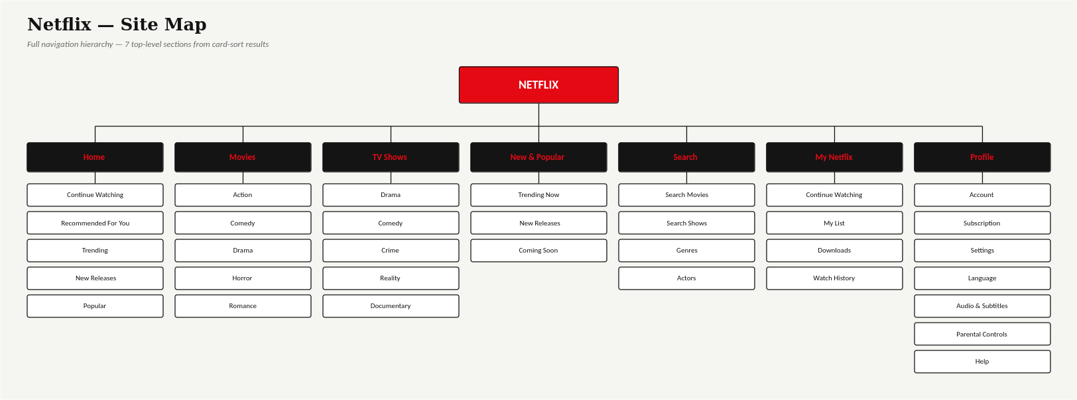
02 · STRUCTURE
Card Sorting → Information Architecture
7 top-level sections, derived from open + closed card-sort agreement scores — not guesswork.
Netflix UX Case Study
4

Slide 5
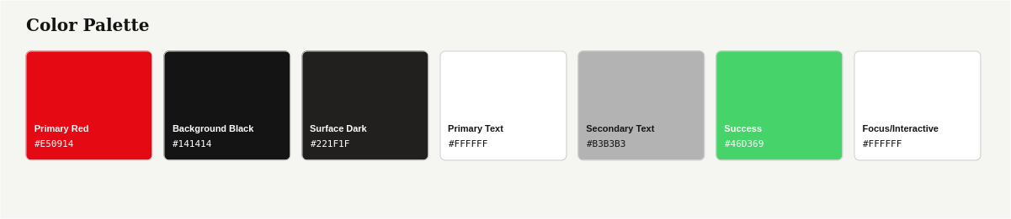
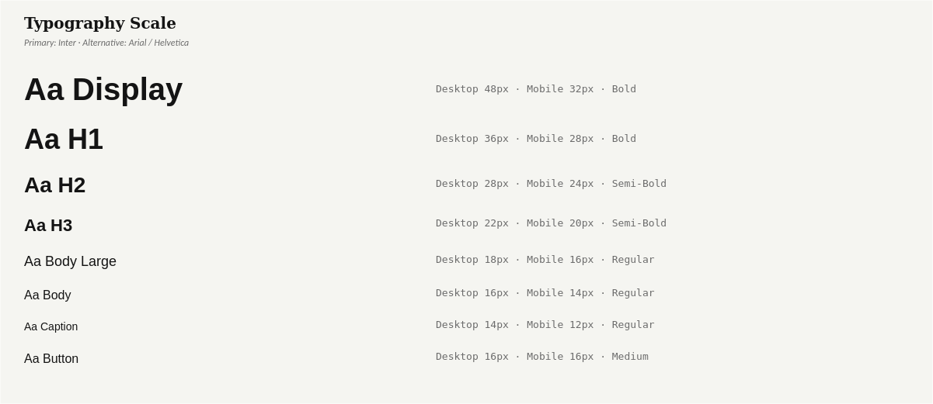
03 · DESIGN SYSTEM
Wireframes → Design Tokens
12-COLUMN DESKTOP / 4-COLUMN MOBILE GRID
80px margin / 24px gutter desktop · 16px / 16px mobile · 1440×1024 and 390×844 frames
9 SPACING TOKENS (4px BASE)
4 · 8 · 12 · 16 · 24 · 32 · 48 · 64 · 96 — every padding and gap in the component library maps to one of these.
WCAG-VERIFIED PALETTE
Every color pairing checked with the real WCAG formula — 2 failures caught and fixed (see slide 9).
Netflix UX Case Study
5

Slide 6
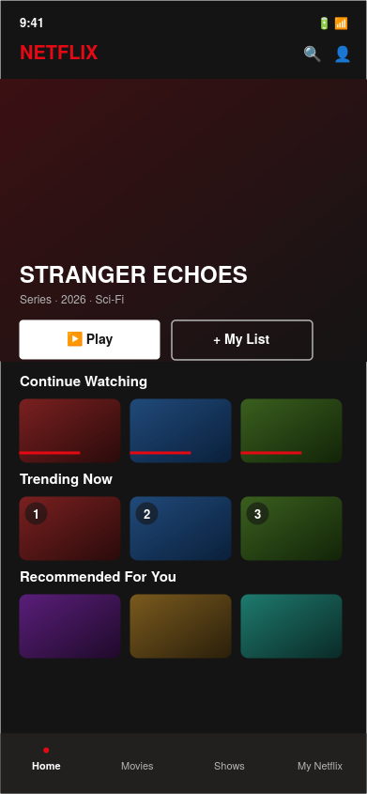
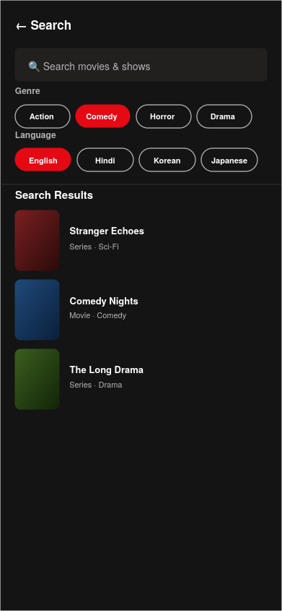
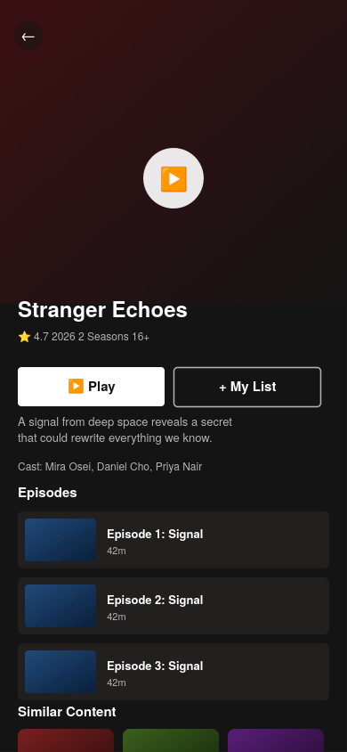
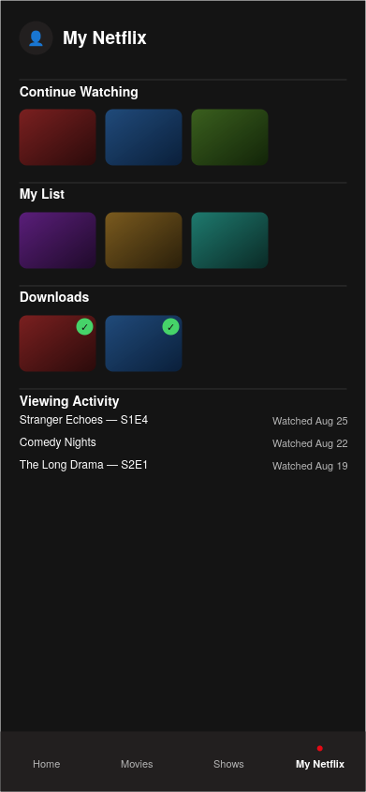
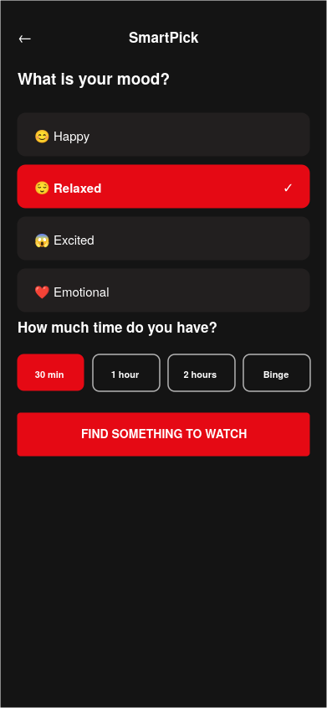
04 · HIGH-FIDELITY UI
Five Core Screens
Home
Search
Movie Details
My Netflix
SmartPick
Netflix UX Case Study
6

Slide 7
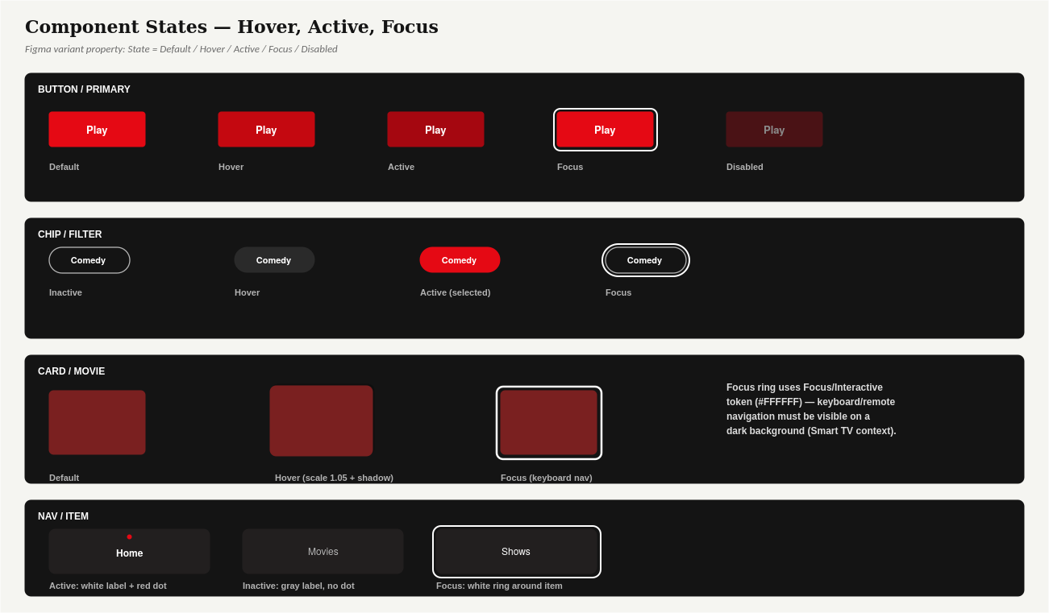
05 · COMPONENT LIBRARY
Reusable Components, Not One-Off Screens
9 master components (Button, Chip, Card, Nav Item, etc.) each with Default/Hover/Active/Focus states — including Focus states for remote/keyboard navigation on TV.
Netflix UX Case Study
7

Slide 8
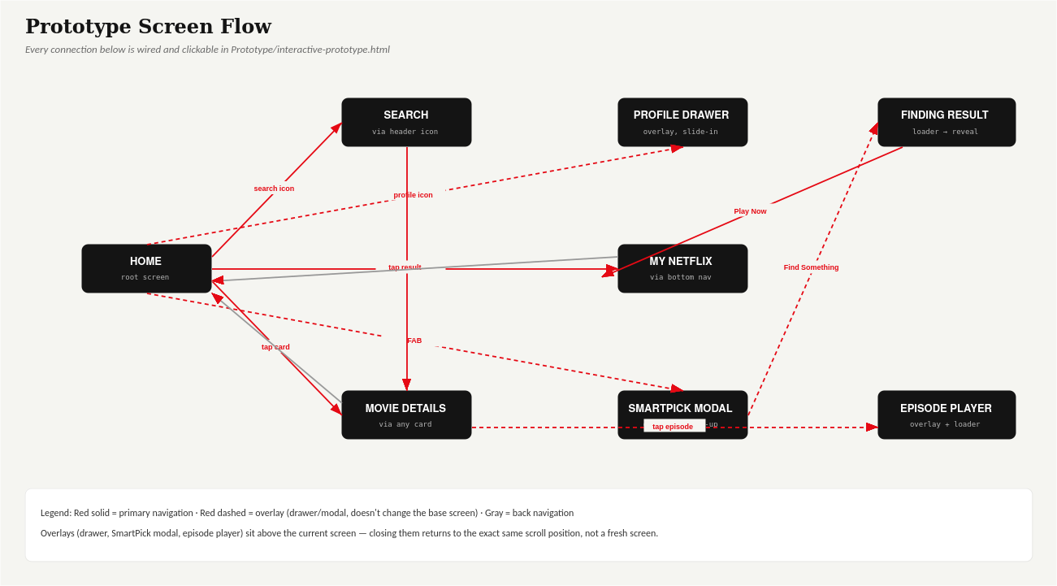
06 · PROTOTYPE
A Real, Clickable Prototype
Netflix UX Case Study
8

Slide 9
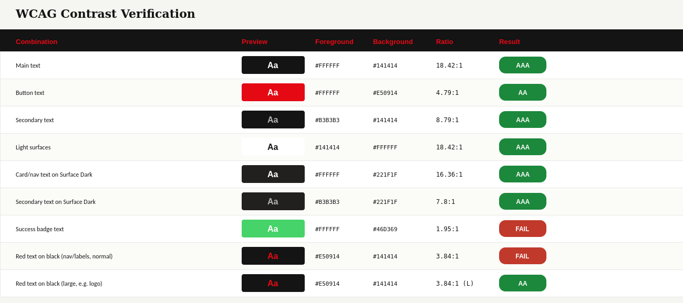
06 · PROTOTYPE
Accessibility, Verified Not Assumed
2 of 9 pairings failed WCAG AA and were fixed: success-badge text switched to black (9.46:1); red text on black restricted to large/bold sizes only.
Netflix UX Case Study
9

Slide 10
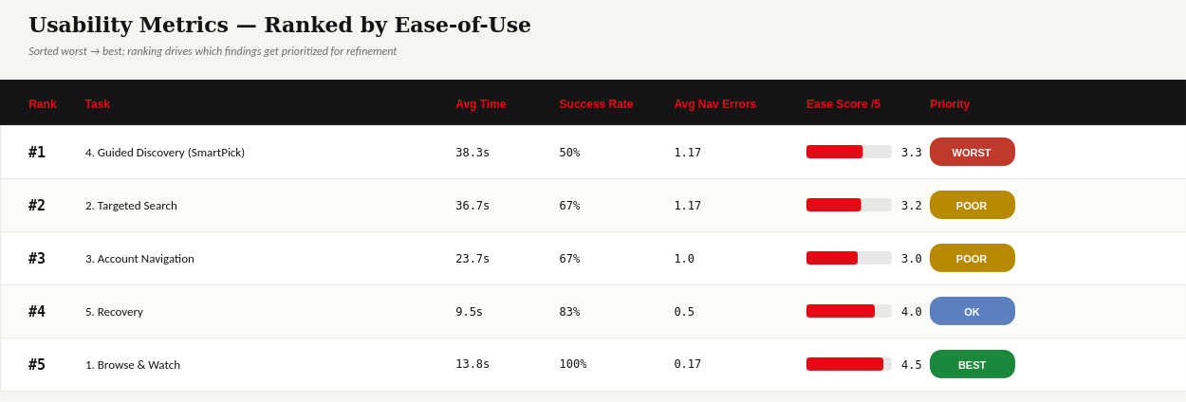
07 · USABILITY TESTING
Testing It On Real Tasks
6 participants × 5 tasks. SmartPick discoverability (50% success) and search filter clarity (67%) ranked worst — against a 100%-success browsing baseline.
Netflix UX Case Study
10

Slide 11
07 · USABILITY TESTING
Findings → Fixes
SmartPick Discoverability
1
Added a one-time “Try SmartPick” label nudge near the FAB, plus a descriptive aria-label.
Drawer Close Affordance
2
Added an explicit ✕ button at the drawer's top-right — the position people expect it.
Search Chip Clarity
3
Added a one-line hint: “Tap to combine filters — multiple can be active at once.”
Deliberately not touched: Browse & Watch (100% success, 4.5/5 ease) — no reason to risk regressions on what already works.
Netflix UX Case Study
11

Slide 12
SUMMARY
One Traceable Chain
From “users spend too much time deciding what to watch” to a WCAG-verified, usability-tested, refined interactive prototype — every design decision in this case study traces back to a specific research finding, card-sort score, or test result.
Research
Personas
Card Sort → IA
Journeys
Wireframes
Design System
Components
Prototype
WCAG Audit
Usability Testing
Refinements
Full case study: Final_Case_Study/Netflix_UX_Case_Study.md · Live prototype: Prototype/interactive-prototype.html

